Slide 1




University
Logo 1
AI-Assisted Business Data Analytics & Management System
Team Members
Prince Patel -24CS072
Manav Patel -24CS067
Srujal Patel -24CS076
Team Lead & Backend Developer
Frontend Developer & UI/UX Designer
AI/ML Engineer & Database Architect
Visit us at
https://dataxpert.dev
Department of Computer Science & Engineering ,CSPIT

Slide 2
What is DataXpert?
DataXpert is an intelligent web platform that helps businesses understand their data better.
Core Idea
"Making data analysis simple and accessible for everyone - no technical expertise required."
Think of it as your personal data analyst that:
Takes your business data (sales, expenses, profits)
Key Highlight
Creates beautiful visual charts and graphs
Answers your questions in plain English
💡 Chat with AI like talking to a colleague:
"How were my sales last month?" and get instant, intelligent answers.
Finds unusual patterns automatically
Helps you make smarter business decisions
Department of Computer Science & Engineering ,CSPIT

Slide 3
The Problem We're Solving
Data Overload
Time-Consuming
Lack of Insights
Businesses collect tons of data but struggle to make sense of it
Creating reports and charts manually is tedious
Hard to spot trends without data expertise
No quick answers to urgent business questions
Unusual patterns go unnoticed until it's too late
Manual analysis in Excel takes hours or days
Expensive Solutions
Technical Barriers
Enterprise analytics tools cost thousands of dollars
Requires data science knowledge
Small businesses can't afford complex software
Not everyone can write complex formulas or code
The Result
Delayed decisions, missed opportunities, and wasted time
Department of Computer Science & Engineering ,CSPIT

Slide 4
Who Can Use DataXpert?
1. Small Business Owners
2. Retail Shop Managers
Track sales and profits easily
Monitor daily sales and inventory
Get quick answers without hiring analysts
Identify best-selling products
Make data-driven decisions confidently
Spot unusual sales patterns
3. Financial Managers
4. Entrepreneurs & Startups
Analyze expenses and revenue trends
Budget-friendly analytics solution
Generate reports quickly
Simple interface, no training needed
Forecast future performance
Focus on growth, not spreadsheets
5. Data Analysts
Save time on repetitive analysis
Upload bulk data efficiently
Export results for detailed reports
Common Need
All want to understand their data quickly, easily, and affordably.
Department of Computer Science & Engineering ,CSPIT

Slide 5
Our Solution - Why DataXpert?
The Gap
Complex Tools
Simple Spreadsheets
Too expensive & hard
Too basic & slow
DataXpert Fills This Gap ✨
1. Talk to Your Data
2. See Everything Clearly
3. AI Does the Heavy Lifting
Ask questions in plain English
Beautiful, interactive charts
Automatic pattern detection
Get instant, intelligent answers
Real-time dashboard updates
Smart forecasting
No coding or formulas needed
Understand trends at a glance
Anomaly alerts
4. Access Anywhere
5. Easy to Use
Cloud-based, no installation
Upload CSV/Excel files in seconds
Works on phone, tablet, laptop
Intuitive interface
Secure data storage
Start analyzing immediately
Department of Computer Science & Engineering ,CSPIT

Slide 6
What DataXpert Can Do For You
1. Smart Authentication
2. Easy Data Upload
3. Interactive Dashboard
4. AI Chat Analysis
• Email/Password login
• Drag & drop CSV/Excel
• Real-time charts
• Ask natural questions
• Quick Google sign-in
• Automatic validation
• Key metrics at a glance
• Instant insights
• Secure profile management
• Supports sales, expenses
• Mobile-responsive
• Natural language
5. Anomaly Detection
6. Trend & Forecasting
7. Export Data
8. User-Friendly Design
• Automatic pattern spotting
• See sales trends
• Download CSV, Excel, JSON
• Dark/Light theme
• Alerts for suspicious data
• Predict performance
• Share reports easily
• Clean, modern interface
• Prevent errors and fraud
• Compare time periods
• Keep data portable
• Fast and responsive
AI Chat in Action
User asks:
AI responds:
"What were my best-selling products?"
Instant insights with explanations and visual charts
Department of Computer Science & Engineering ,CSPIT

Slide 7
System Architecture - Three Layers
FRONTEND LAYER
BACKEND LAYER
What Users See
The Brain
HTML
CSS
JavaScript
Flask REST API
JWT Auth
Chart.js Visuals
Responsive Design
AI Analysis Engine
DATABASE LAYER
Data Storage
Supabase
PostgreSQL
Secure & Scalable
How They Work Together:
1
2
3
4
5
6
User interacts
with Frontend
Frontend sends
request to Backend
Backend processes
with AI
Backend fetches/stores
data in Database
Results return
to Frontend
User sees
the answer
Department of Computer Science & Engineering ,CSPIT

Slide 8
Technology Stack - Our Toolkit
Frontend
Backend
Database
User Interface
Server
Data Storage
HTML5 - Structure
Python - Programming
Supabase - Cloud Platform
CSS3 - Styling
Flask - Web Framework
PostgreSQL - Relational DB
JavaScript - Interactivity
JWT - Authentication
Real-time Data Sync
Chart.js - Visualization
RESTful API - Communication
AI & ML
Deployment
Security
Intelligence
Hosting
Protection
Pandas - Data Manipulation
Render - Backend Hosting
HTTPS - Encrypted
NumPy - Numerical Computing
Vercel - Frontend Hosting
Password Hashing (SHA-256)
Scikit-learn - ML Algorithms
GitHub - Version Control
CORS Protection
NLP - Language Processing
SQL Injection Prevention
Why These Tools?
Open-source and reliable
Industry-standard technologies
Scalable and maintainable
Great community support
Department of Computer Science & Engineering ,CSPIT

Slide 9
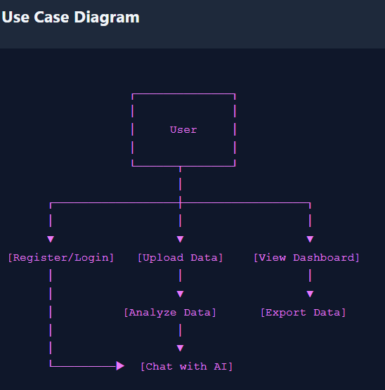
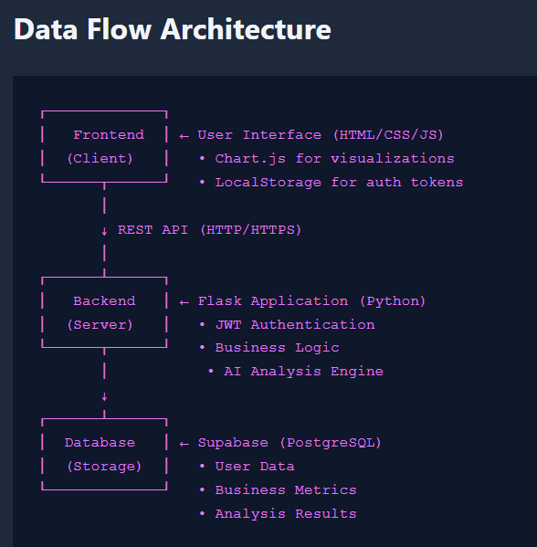
How DataXpert Works - User Journey
User Chooses Action:
Upload Data
Validate → Save to Database → Success ✓
View Dashboard
Fetch Data → Generate Charts → Display
Chat with AI
Process Query → AI Analysis → Show Answer
Export Data
Select Format → Generate File → Download ✓
Key Points:
Every action is secure (requires authentication)
Data is validated before processing
AI analyzes in real-time
Results are instant
Department of Computer Science & Engineering ,CSPIT

Slide 10
How We Built DataXpert - Our Journey
Timeline: 12 Weeks
1-2
3-4
5-7
8-9
10-11
12
Planning & Research
Design Phase
Development Phase
Integration & Testing
Deployment
Documentation
• Identified problem
• Database schema
• Built frontend
• Connected layers
• Deployed backend
• SRS document
• Researched solutions
• UI mockups
• Backend API
• Tested features
• Deployed frontend
• Technical docs
• Defined features
• API endpoints
• Database setup
• Fixed bugs
• Security config
• Final testing
• Created roadmap
• Tech stack
• AI integration
• Optimized
• Monitoring
• Presentation
Development Approach:
Agile Methodology
Regular Meetings
Version Control
Continuous Testing
Iterative development
Team collaboration
Git & GitHub
Quality assurance
Department of Computer Science & Engineering ,CSPIT

Slide 11
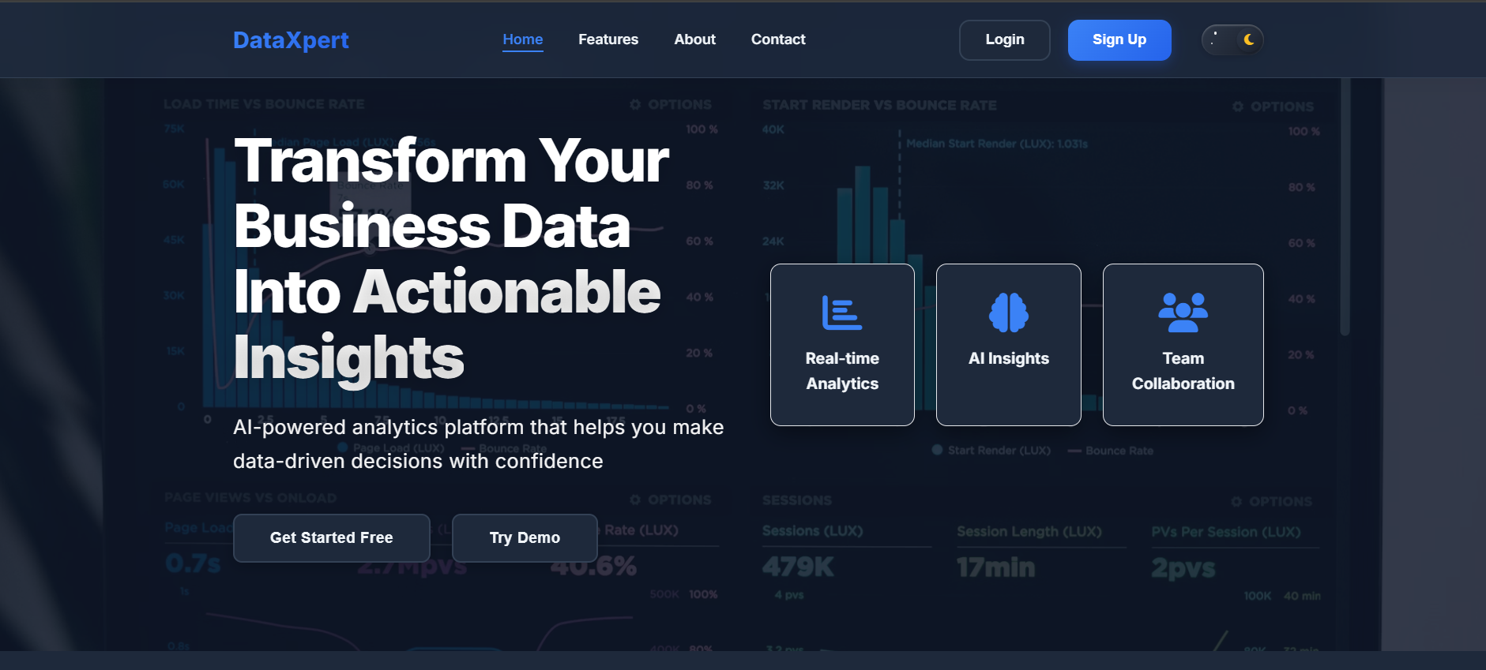
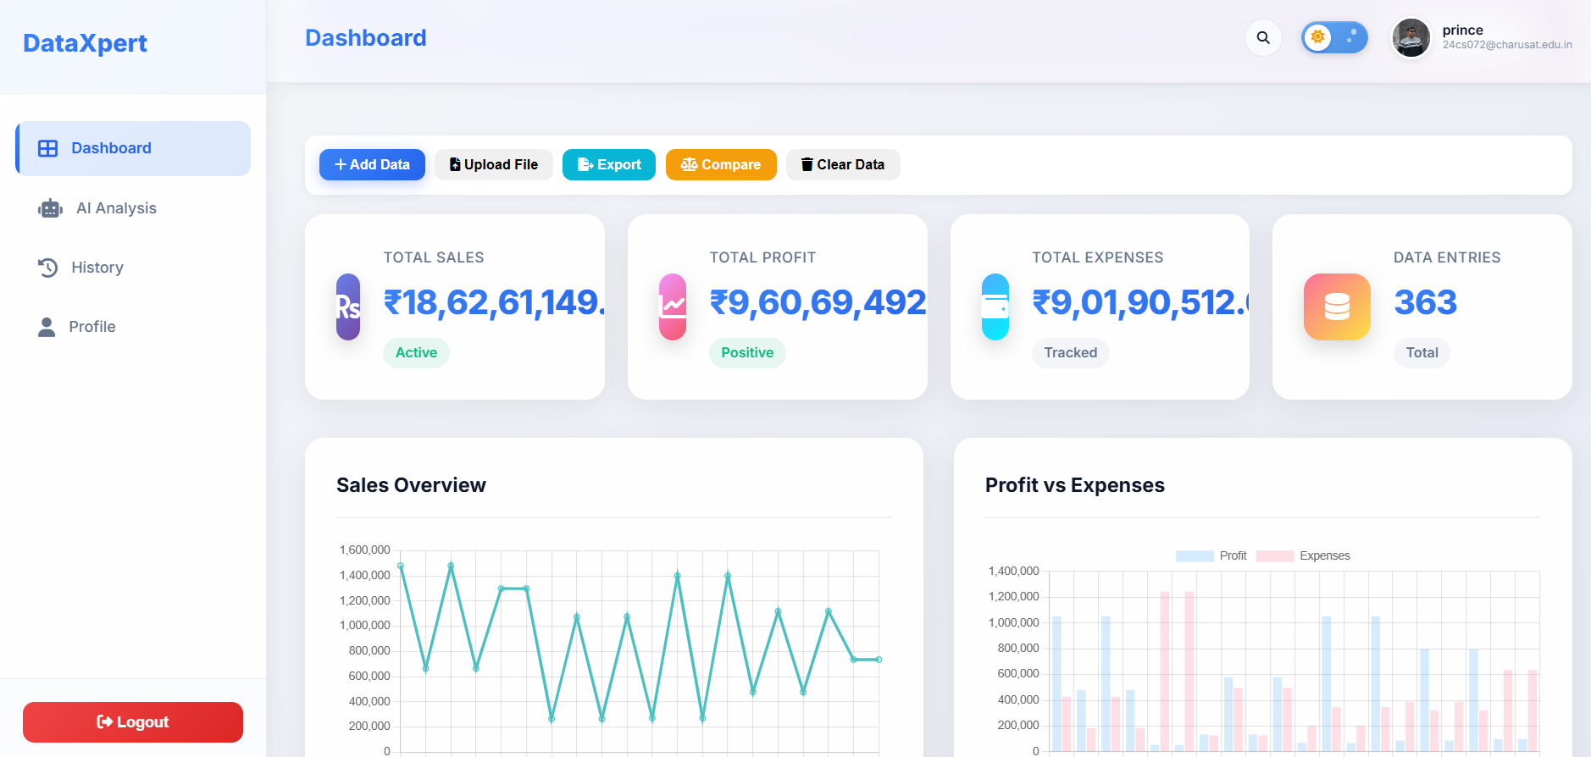
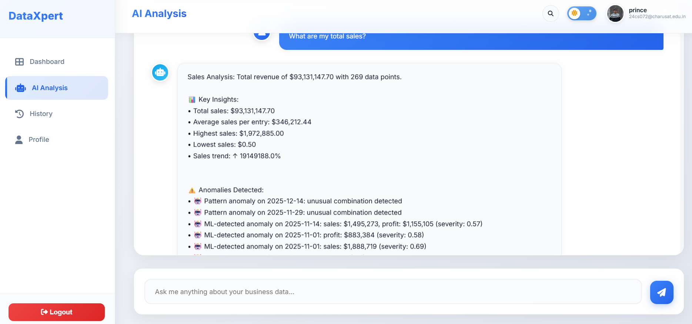
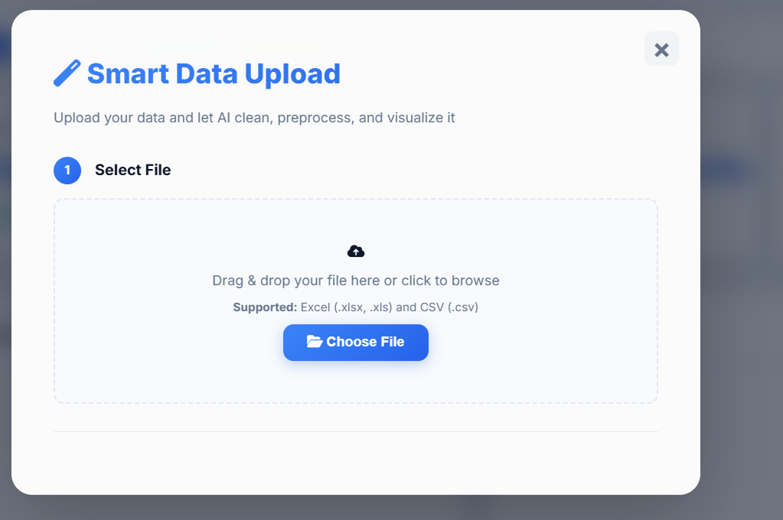
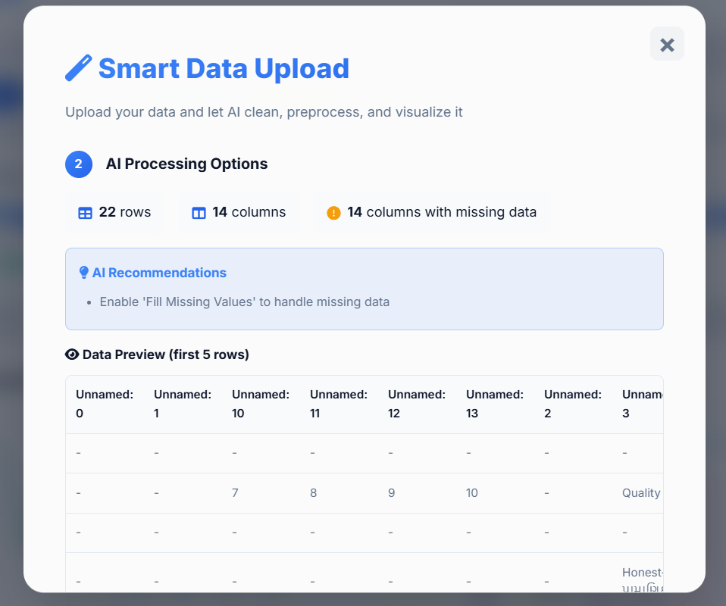
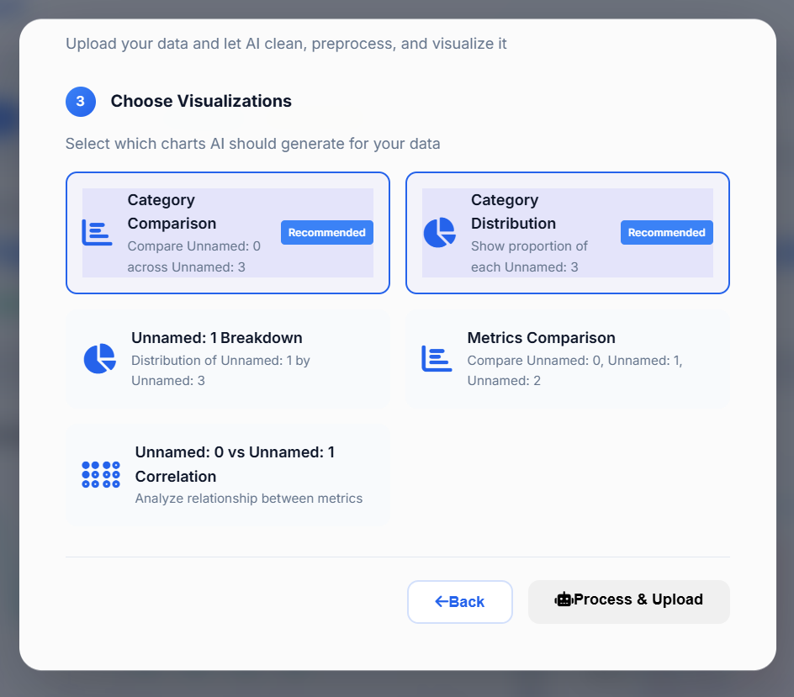
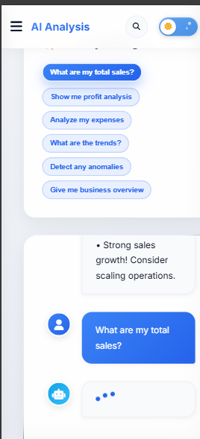
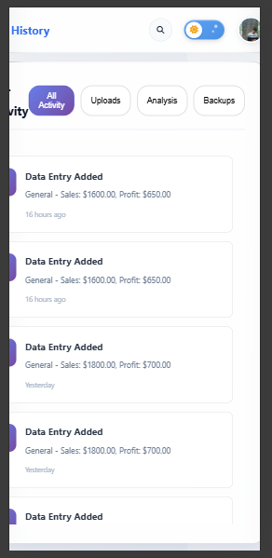
DataXpert in Action - Preview
Screenshot 1: Dashboard
Screenshot 2: AI Chat Interface
Real-time metrics cards
User: "What were my sales in January?"
Interactive charts
AI: "Your total sales in January were $45,230..."
Clean, modern design
Data Upload Screen
Screenshot 3: Data Upload
Screenshot 4: Mobile View
Drag & drop file upload
Fully responsive
Automatic validation
Works on any device
Progress indicator
Same features, optimized UI
Department of Computer Science & Engineering ,CSPIT

Slide 12
Challenges We Faced & What We Learned
1. CORS Configuration
2. Google OAuth Integration
Challenge:
Challenge:
Cross-origin requests blocked
Complex authentication flow
Solution:
Solution:
Properly configured allowed origins
Studied documentation, tested approaches
Learning:
Learning:
Understood web security fundamentals
Mastered OAuth 2.0 protocol
3. Deployment Issues
4. AI Intent Extraction
Challenge:
Challenge:
Server cold starts, slow responses
Understanding varied user questions
Solution:
Solution:
Implemented keep-alive strategies
Built robust NLP patterns
Learning:
Learning:
Cloud hosting best practices
NLP techniques
5. Real-time Updates
Challenge:
Solution:
Learning:
Keeping dashboard synchronized
Efficient API calls and state management
Performance optimization
Key Takeaways:
Full-stack development skills
Problem-solving and debugging
Team collaboration
Real-world project experience
Cloud deployment knowledge
Department of Computer Science & Engineering ,CSPIT

Slide 13
Conclusion & What's Next
Summary: DataXpert successfully bridges the gap between complex analytics tools and simple spreadsheets. We created an AI-powered platform that makes data analysis accessible, affordable, and easy for everyone.
What We Achieved
Impact
Fully functional web application
Saves hours of manual analysis time
AI-powered insights
Empowers non-technical users with AI
Secure and scalable architecture
Provides affordable analytics solution
Cloud-deployed worldwide
Demonstrates practical AI/ML application
Complete technical documentation
Short-term (3-6 months)
Long-term (6-12 months)
Mobile app (iOS & Android)
Accounting software integration
Advanced ML models
Team collaboration features
Multi-language support
Custom report templates
More chart types and visualizations
API for third-party integrations
Premium features
Email notification alerts
Vision
"To become the go-to analytics platform for small and medium businesses worldwide."
Department of Computer Science & Engineering ,CSPIT

Slide 14
Thank You!
"Thank you for your time and attention"
Project Links & Contact us
dataxpert.dev
GitHub
Instagram
Questions & Answers
We're ready to answer your questions!
Department of Computer Science & Engineering ,CSPIT

